Slide 1
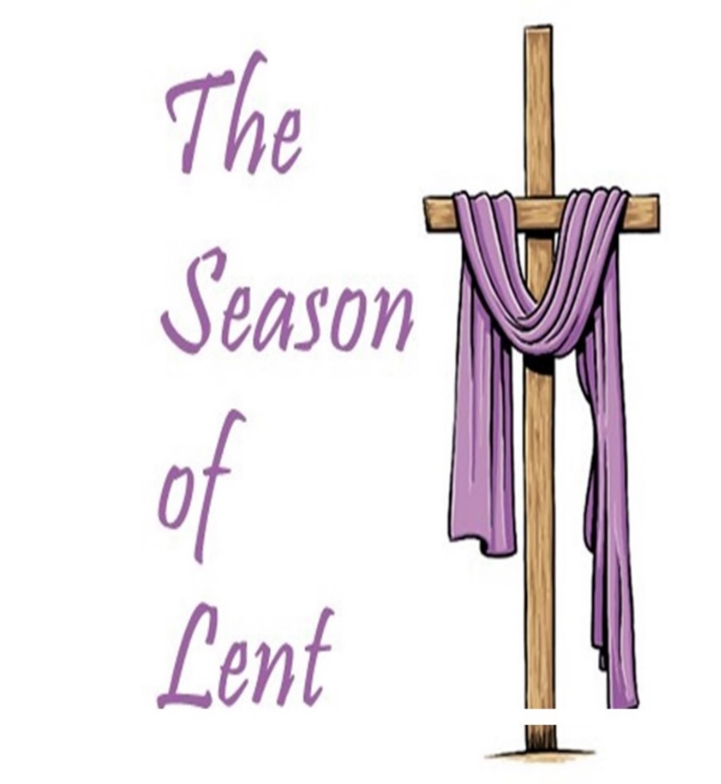
The Second Sunday of Lent
Hoover First UMC
Rev. Jimmy Bassham

Slide 2
Gathering Music
Joyce Godwin, Harpist
Connie Logan, Organist

Slide 3
Welcome & Announcements
Men’s Chili Supper
March 13th
5-7pm

Slide 4
Prelude “Alas! and Did My Savior Bleed” Hoover First Music Trio

Slide 5
Choral Call to Worship
“Spirit Song”
J. Wimber
The Chancel Choir

Slide 6
*Hymn of Praise
“Ask Ye What Great Thing
I Know”
UMH 163, v. 1 - 4

Slide 7
1. Ask ye what great thing I know, that delights and stirs me so?

Slide 8
What the high reward I win? Whose the name I glory in? Jesus Christ, the crucified.

Slide 9
2. Who defeats my fiercest foes? Who consoles my saddest woes?

Slide 10
Who revives my fainting heart, healing all its hidden smart? Jesus Christ, the crucified.

Slide 11
3. Who is life in life to me? Who the death of death will be?

Slide 12
Who will place me on his right, with the countless hosts of light? Jesus Christ, the crucified.

Slide 13
4. This is that great thing I know; this delights and stirs me so:

Slide 14
faith in him who died to save, him who triumphed o’er the grave: Jesus Christ, the crucified.

Slide 15
*Collect
Lord, I want to be more holy in my heart. Here is the citadel of all my desiring, where my hopes are born and all the deep resolutions of my spirit take wings. In this center, my fears are nourished, and all my hates are nurtured.

Slide 16
Here my loves are cherished, and all the deep hungers of my spirit are honored without quivering and without shock. In my heart, above all else,

Slide 17
let love and integrity envelop me until my love is perfected and the last vestige of my desiring is no longer in conflict with your Spirit.
Lord, I want to be more holy in my heart. Amen.

Slide 18
*Gloria Patri
Glory be to the Father and to the Son and to the Holy Ghost;
as it was in the beginning, is now, and ever shall be, world without end. Amen. Amen.

Slide 19
Hymn
“O How I Love Jesus”
UMH 170 v. 1 - 3

Slide 20
1. There is a name I love to hear, I love to sing its worth; it sounds like music in my ear, the sweetest name on earth.

Slide 21
Refrain
O how I love Jesus, O how I love Jesus, O how I love Jesus, because he first loved me!

Slide 22
2. It tells me of a Savior’s love, who died to set me free; it tells me of his precious blood, the sinner’s perfect plea.

Slide 23
Refrain
O how I love Jesus, O how I love Jesus, O how I love Jesus, because he first loved me!

Slide 24
3. It tells of one whose loving heart can feel my deepest woe; who in each sorrow bears a part that none can bear below.

Slide 25
Refrain
O how I love Jesus, O how I love Jesus, O how I love Jesus, because he first loved me!

Slide 26
Sharing of Joys & Concerns

Slide 27
Hoover First Prayer List
Nell Howell
Ruth Nolen
Carol Collier
Tom and Pat Temple
Temmie Bibb, friend of Wilson
and Eleanor Talmadge
James Herron
Teresa Wood

Slide 28
Jay and Lynn Howell, son and
daughter-in-law of Nell Howell
Mike Chumley, friend of
Jeff Haizlip
Tom & Dinah Remington,
friends of Barbara A.
Lori Mitchell, friend of Sherri
Bassham

Slide 29
Robin Alyson, sister-in-law
of Laurel Hoag
Len Rhodes, daughter
of Nell Howell
Reese Wilson, friend
of Barbara A.
The family of Pay Medlin,
cousin of Renee Norton

Slide 30
Choral Call to Prayer
“God So Love the World”
Beethoven
Arr. D. McIntyre

Slide 31
Silent Meditation
& Prayer
The Pastoral Prayer

Slide 32
The Lord’s Prayer
Our Father, who art in heaven,
hallowed be thy name.
Thy kingdom come,
thy will be done
on earth as it is in heaven.

Slide 33
Give us this day
our daily bread.
And forgive us our trespasses,
as we forgive those who
trespass against us.

Slide 34
And lead us not into temptation
but deliver us from evil.
For thine is the kingdom,
and the power,
and the glory, forever.
Amen.

Slide 35
Income received as of 2-18-2023
$20,485.00

Slide 36
Anthem
“You Alone Are Holy”
Anon.
The Chancel Choir
Tammi Powell, Director

Slide 37
Scripture Lesson Philippians 3: 4b - 14
^{4b} If anyone else has reason to be confident in the flesh, I have more: ⁵ circumcised on the eighth day, a member of the people of Israel, of the tribe of Benjamin, a Hebrew born of Hebrews; as to the law, a Pharisee;

Slide 38
⁶ as to zeal, a persecutor of the church; as to righteousness under the law, blameless. ⁷ Yet whatever gains I had, these I have come to regard as loss because of Christ.

Slide 39
⁸ More than that, I regard everything as loss because of the surpassing value of knowing Christ Jesus my Lord. For his sake I have suffered the loss of all things, and I regard them a rubbish, in order that I may gain Christ

Slide 40
⁹ and be found in him, not having a righteousness of my own that comes from the law, but one that comes through faith in Christ, the righteousness from God based on faith.

Slide 41
¹⁰ I want to know Christ and the power of his resurrection and the sharing of his sufferings by becoming like him in his death, ¹¹ if somehow I may attain the resurrection from the dead.

Slide 42
¹² Not that I have already obtained this or have already reached the goal; but I press on to make it my own, because Christ Jesus has made me his own.

Slide 43
¹³ Beloved, I do not consider that I have made it my own; but this one thing I do: forgetting what lies behind and straining forward to what lies ahead,
¹⁴ I press on toward the goal for the prize of the heavenly call of God in Christ Jesus.

Slide 44
“That One Thing”
Rev. Jimmy Bassham

Slide 45
*Hymn of Dedication
“Am I a Solider
of the Cross”
UMH 511, vs. 1 - 6

Slide 46
1. Am I a soldier of the cross, a follower of the Lamb,

Slide 47
and shall I fear to own his cause, or blush to speak his name?

Slide 48
2. Must I be carried to the skies on flowery beds of ease,

Slide 49
while others fought to win the prize, and sailed through bloody seas?

Slide 50
3. Are there no foes for me to face? Must I not stem the flood?

Slide 51
Is this vile world a friend to grace, to help me on to God?

Slide 52
4. Sure I must fight, if I would reign; increase my courage, Lord.

Slide 53
I’ll bear the toil, endure the pain, supported by thy word.

Slide 54
5. Thy saints in all this glorious war shall conquer, though they die;

Slide 55
they see the triumph from afar, by faith they bring it nigh.

Slide 56
6. When that illustrious day shall rise, and all thy armies shine

Slide 57
in robes of victory through the skies, the glory shall be thine.

Slide 58
*Benediction
*Choral Response
“We Sing of Your Glory”
Arr. C. R. Young

Slide 59
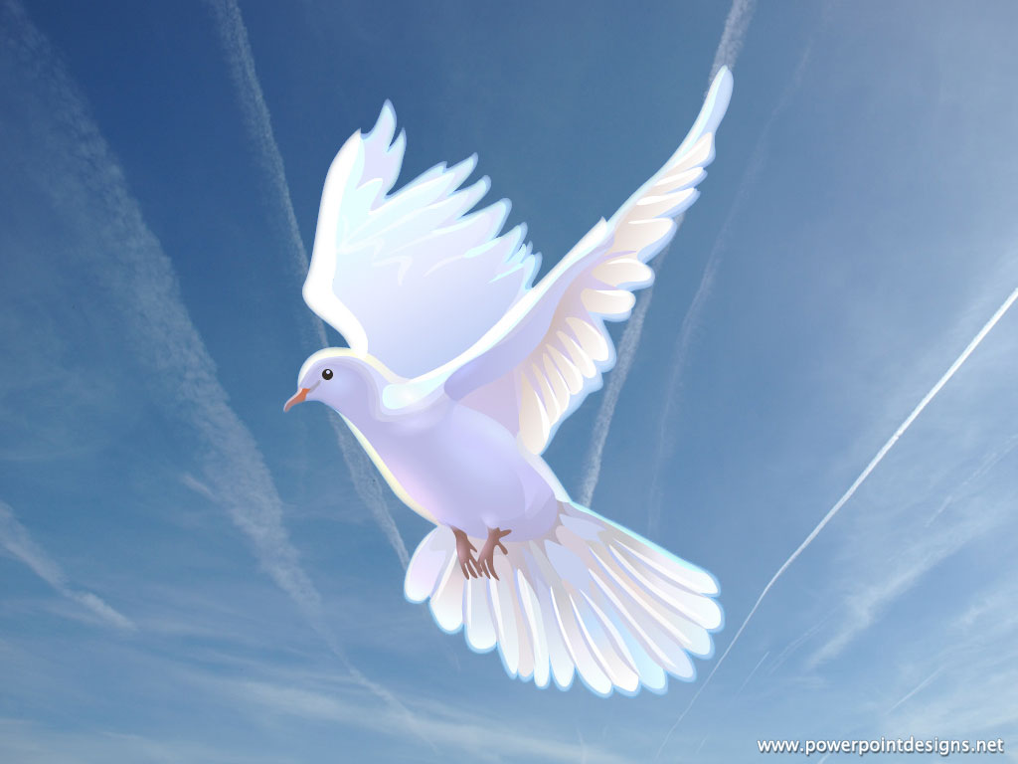
Postlude

